Slide 1

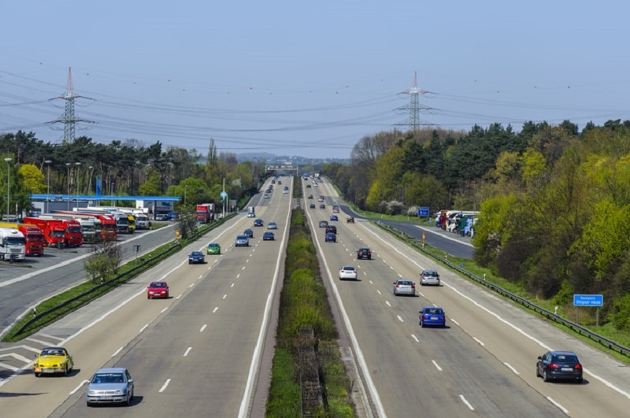
Journal Club Presentation
“Empowering Real-Time Traffic Reporting Systems With NLP-Processed
Social Media Data.”
Presented by – Team Strikers
1. Nannaka Vinila 16328528
2. Potu Laxmidhar 16329635
3. Javvadi Sai Krishna 16327154
4. Hazarath Naveen Kumar Krishnam 16328488

Slide 2

Abstract
Current urbanization trends are leading to heightened demand of smarter technologies to facilitate a variety of applications in intelligent transportation systems. Automated crowdsensing constitutes a strong base for ITS applications by providing novel and rich data streams regarding congestion tracking and real-time navigation.
In this article, we develop an automated “Natural Language Processing (NLP)-based framework” to empower and complement traffic reporting solutions by text mining social media, extracting desired information, and generating alerts and warning for drivers.
We employ the fine-tuned “Bidirectional Encoder Representations from Transformers classification model” to filer and classify data.
Then, we apply the “Question-Answering model” to extract necessary information characterizing the reported incident such as its location, occurrence time, and nature of the incidents.
Afterwards, we converted the collected information into alerts to be integrated into personal navigation assistants. Finally, we compare the recently posted incident reports from both official authorities and social media in order to provide more complete incident pictures and suggest some open research directions.

Slide 3
Introduction
AS THE world’s urban population rapidly grows, cities all over the world are experiencing severe traffic congestion. To address the root problem of urban traffic congestion, many technical solutions have been proposed to provide real time traffic information to drivers. This information can lead them to reroute their trip to avoid congested traffic links in advance.
Novel technologies have been implemented by municipal governments across the United States to provide the basis for such information-based systems.
In Columbus, OH, USA, the city utilizes vehicle-to-infrastructure (V2I) communications systems to collect traffic flow data, which is utilized to time the traffic signal cycles.
In Atlanta, GA, USA, a 2.3-mile smart corridor was opened in 2017. This smart corridor incorporates Internet of Things (IoT) technologies such as sensors, cameras, and wireless communications technology to collect traffic data.
In San Francisco, CA, USA, local authorities installed sensors alongside the roads to identify open street parking, which reduces the amount of time and energy wasted by drivers hunting parking spots.
Researchers have developed systems independently of municipal governments as well.
The authors R. Hussain, F. Abbas introduced a framework to collect accident evidence from vehicular sensors.
The authors H. Yan and D. Yu developed a support vector machine (SVM) model that classifies short-term traffic conditions.

Slide 4
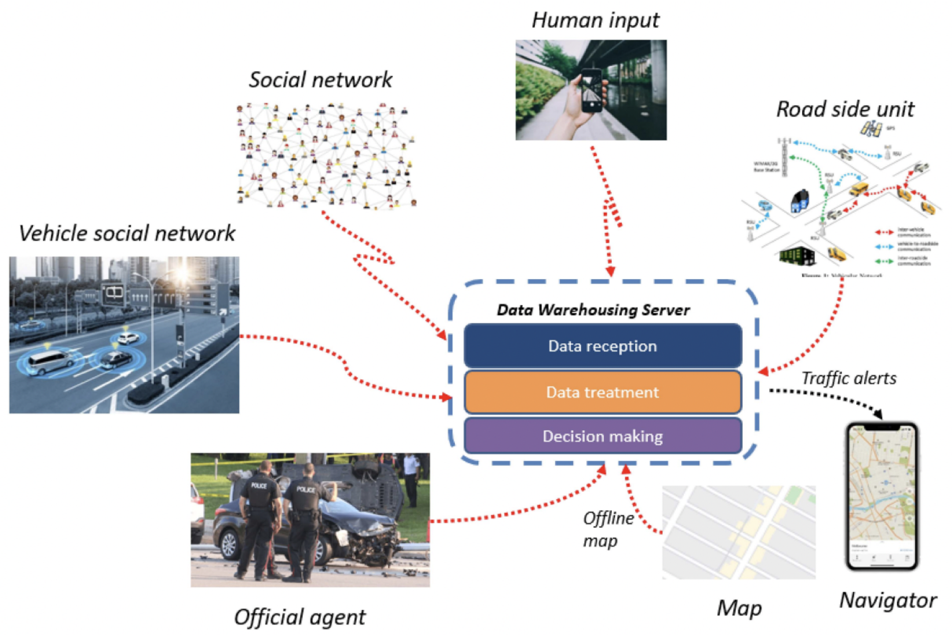
A high-level system architecture illustrating the different crowdsourcing data sources and the main components of the traffic reporting system.
we illustrate a collaborative crowdsourcing framework with multiple input streams. In the framework, the area of interest is managed by a central data warehouse server with multiple functionalities, including acceptance, processing, and preparation of data from multiple sources in order to monitor urban traffic conditions in real-time.
The framework also uses inputs from specialized agencies and from regular people who are not necessarily driving such as cyclists, pedestrians, or passengers in vehicles, ride-sharing taxis, or buses, etc.
The framework automatically browses social media platforms, distinguishes traffic-related messages, extracts/understands the incidents information, and converts them into alerts in the navigation apps.

Slide 5
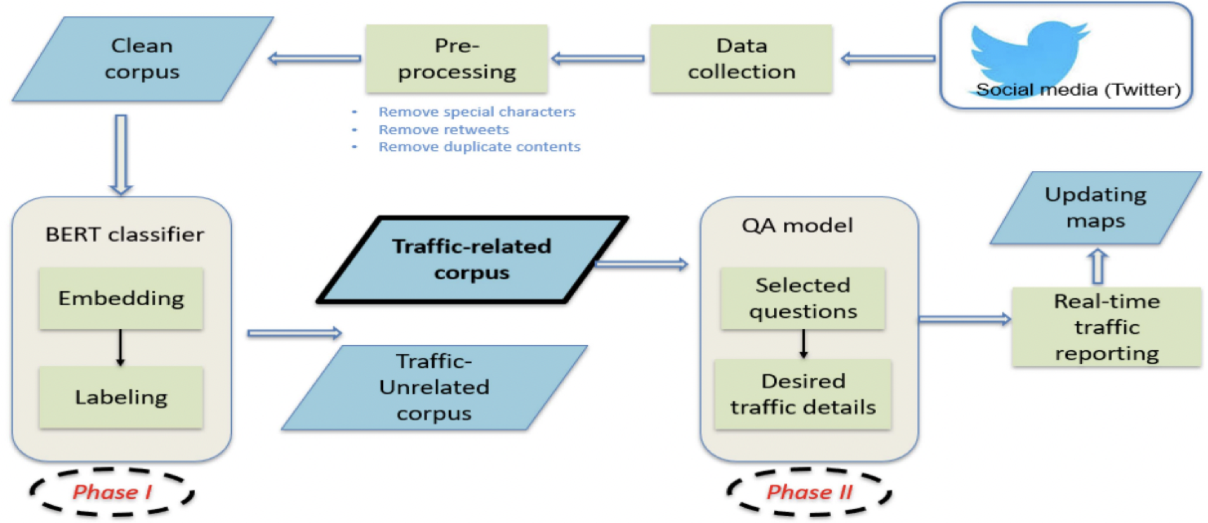
The proposed NLP-based traffic reporting system using social media input.
Previous studies did not develop a systematic method that could automatically extract necessary information from related social posts and build a data pipeline that can be used to update mapping applications in real-time.
In this article, we developed this pipeline and implemented the necessary mechanisms to deliver automated and reliable traffic alerts extracted from social media.

Slide 6
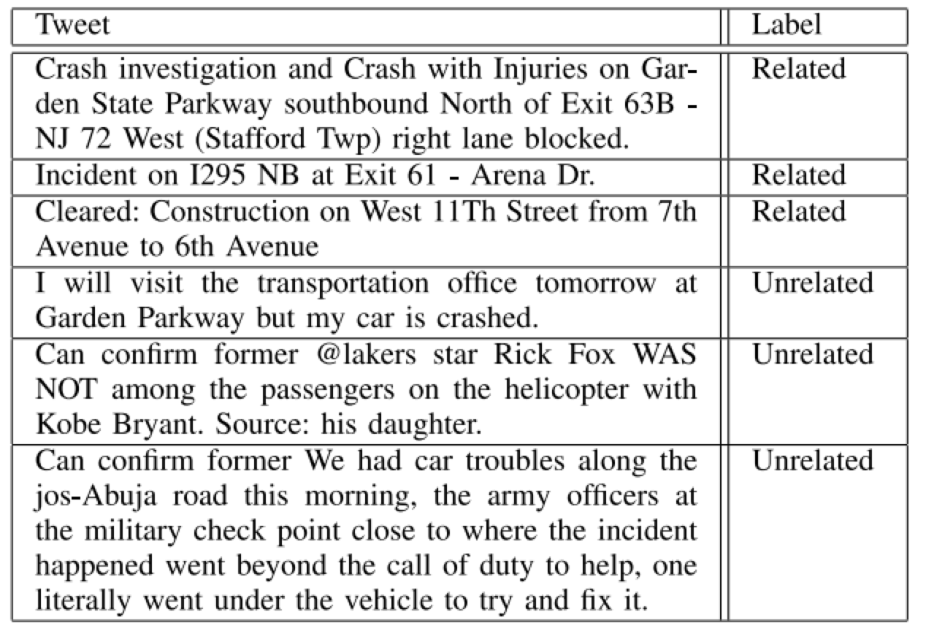
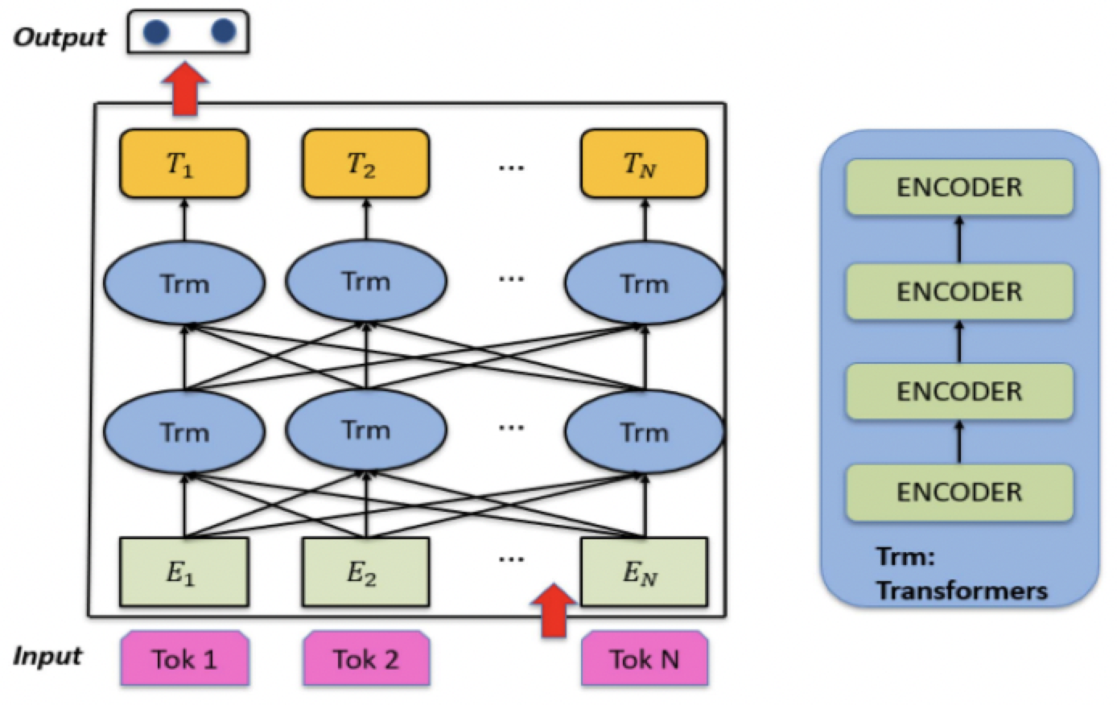
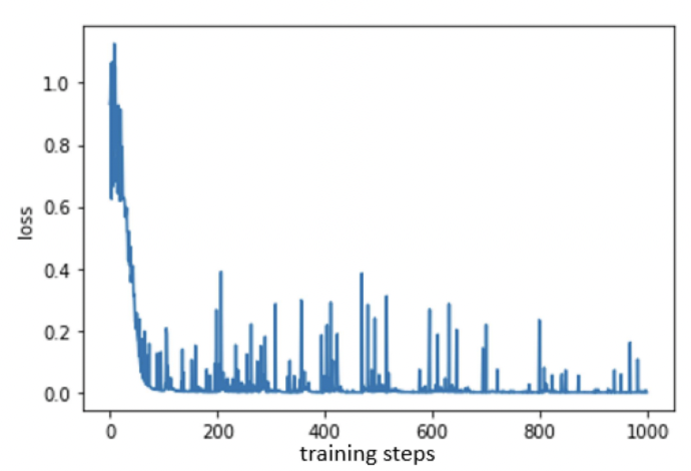
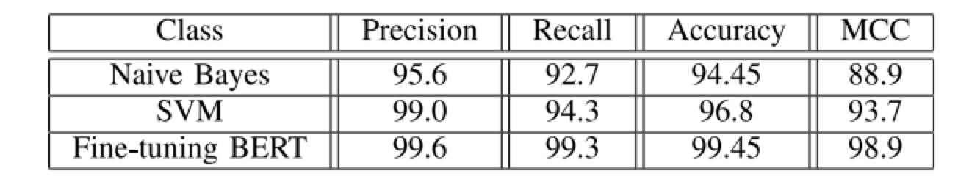
BERT Binary Classification
Architecture of the BERT Binary classification model.
Examples of labeled tweets in the data set.
Training phase of the binary classification model: loss vs. training steps.
Testing phase of binary classification results.

Slide 7
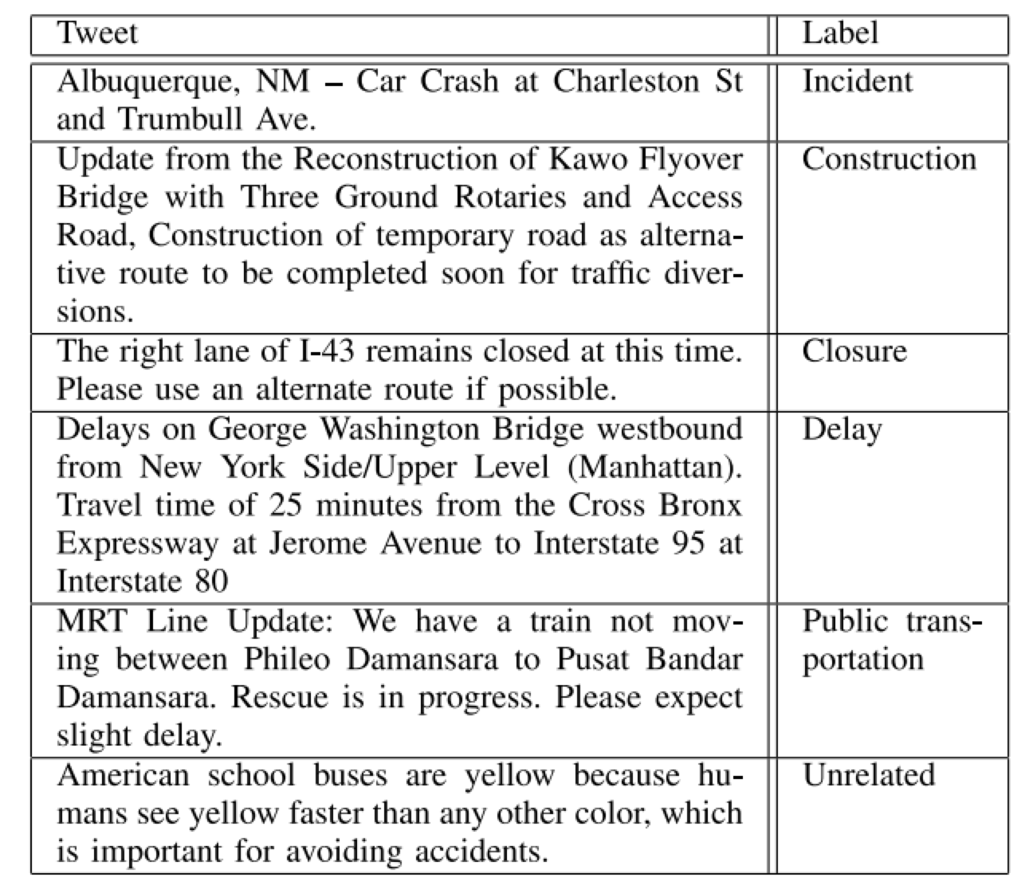
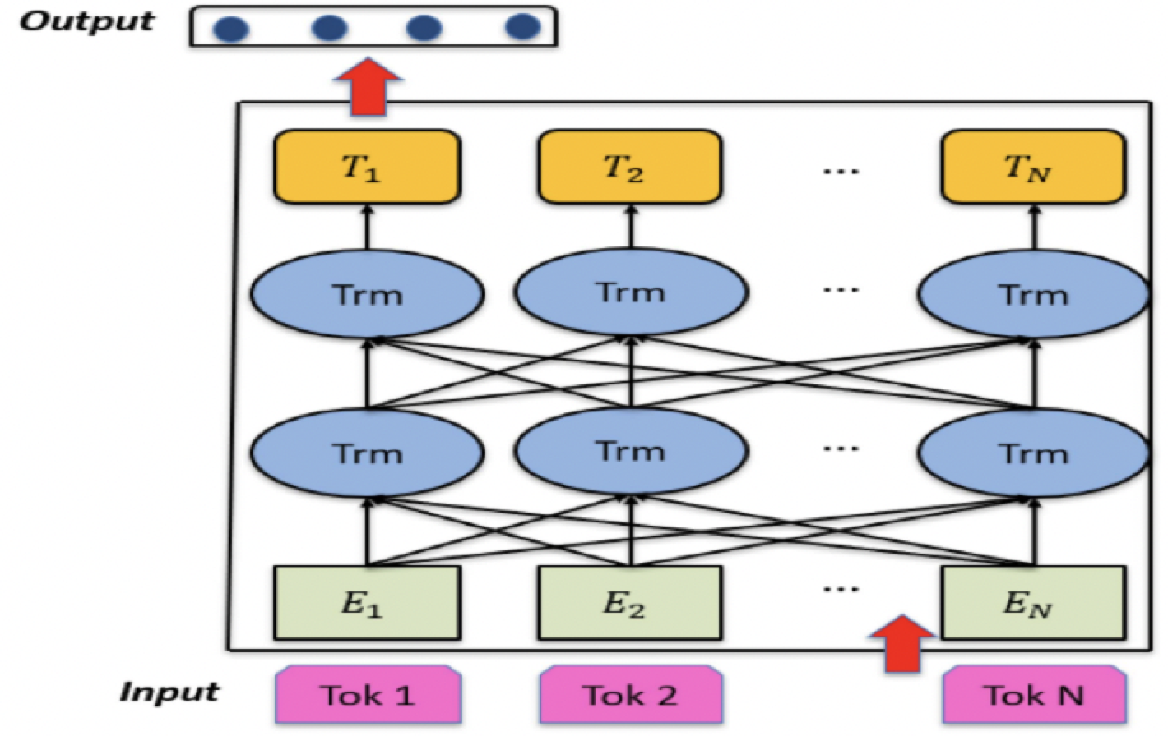
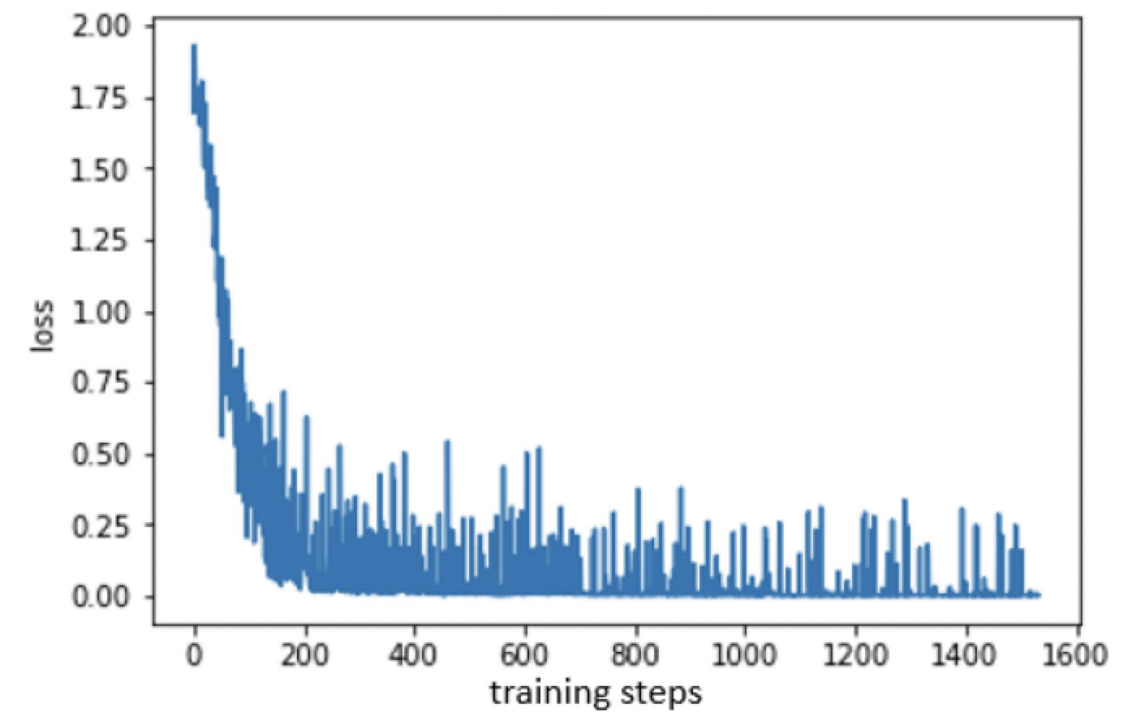
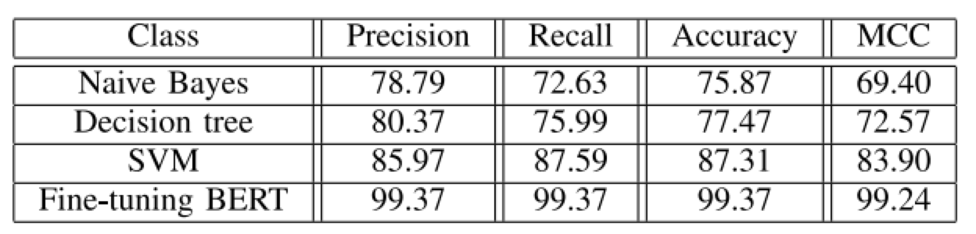
BERT Multi Classification
Architecture of the BERT multi-classification model.
Examples of labeled tweets in the data set.
Training phase of the multi-classification model: loss vs. training steps.
Testing phase of Multi classification results.

Slide 8
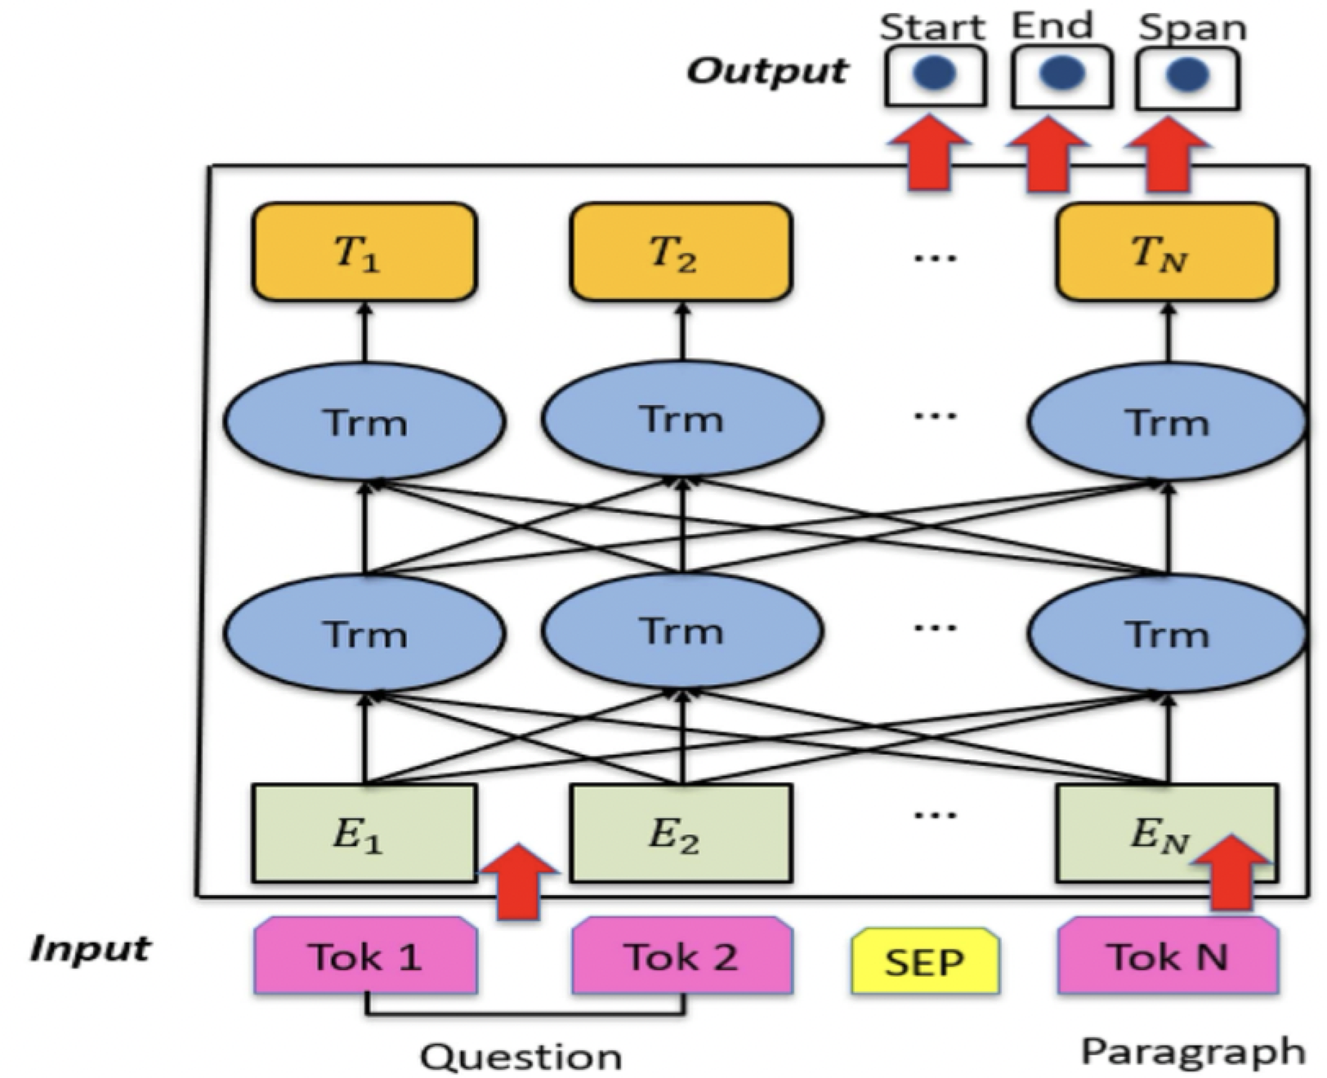

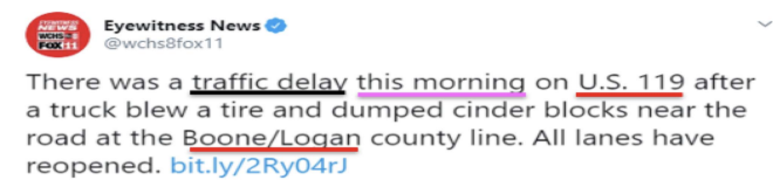
Incident Identification and Extraction
A. QUESTION-ANSWERING MODEL
B. NAME ENTITY RECOGNITION
It is similar to the BERT model’s architecture, with one key difference: the output layer. The data is characterized by three main parts: the question, the data containing the answer (i.e., a tweet), and the separator character SEP, which is between the question and answer parts. The output layer consists of three neurons: “start”, “end”, and “span”.
Another potential solution for extracting specific locations from tweets is through NER. The method locates and classifies named entities from given text including names, locations, etc.
The model achieves 85.9% matching score and 87.7% for F1-score in the validation step. NER achieves slightly better results compared to the QA approach
Examples of the desired traffic
Information extracted using
the question-answering model.
Examples of the desired traffic
Information extracted using
the name-entity recognition model.

Slide 9
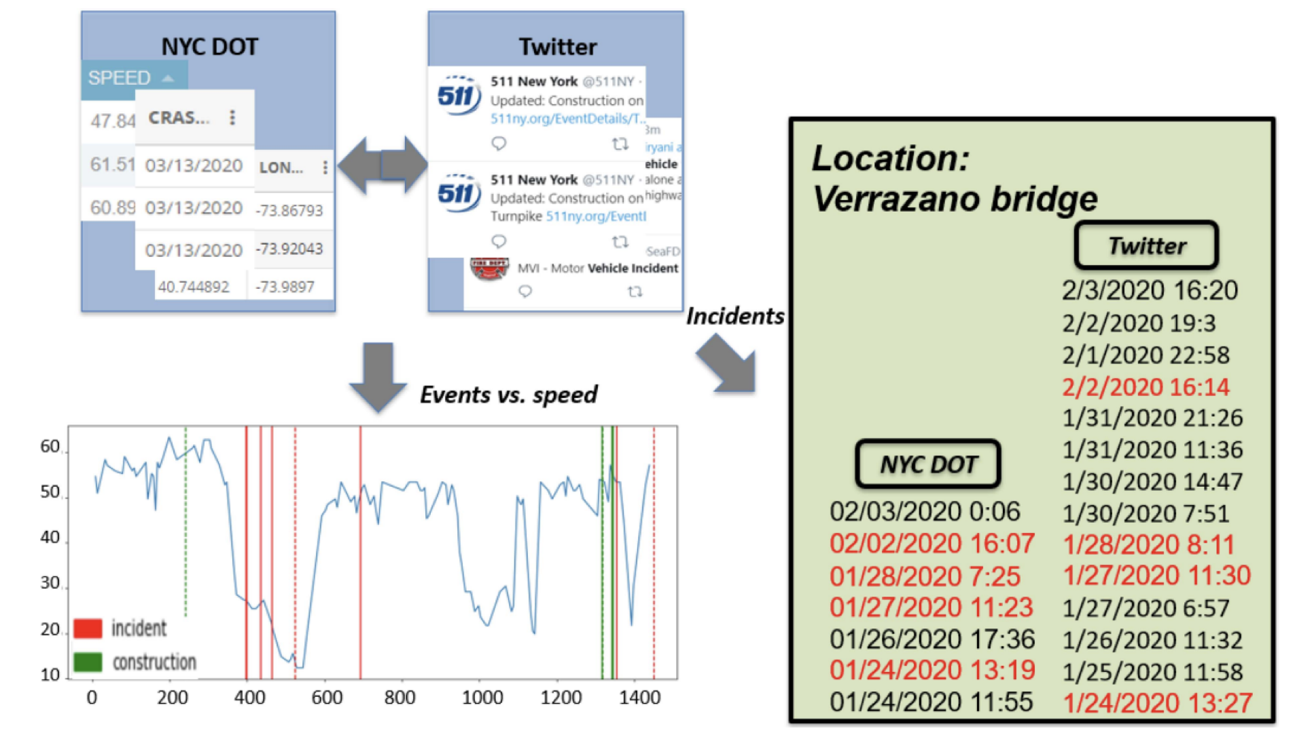
Comparison of traffic information from the NYC DOT and from Twitter using the QA BERT model.

Slide 10
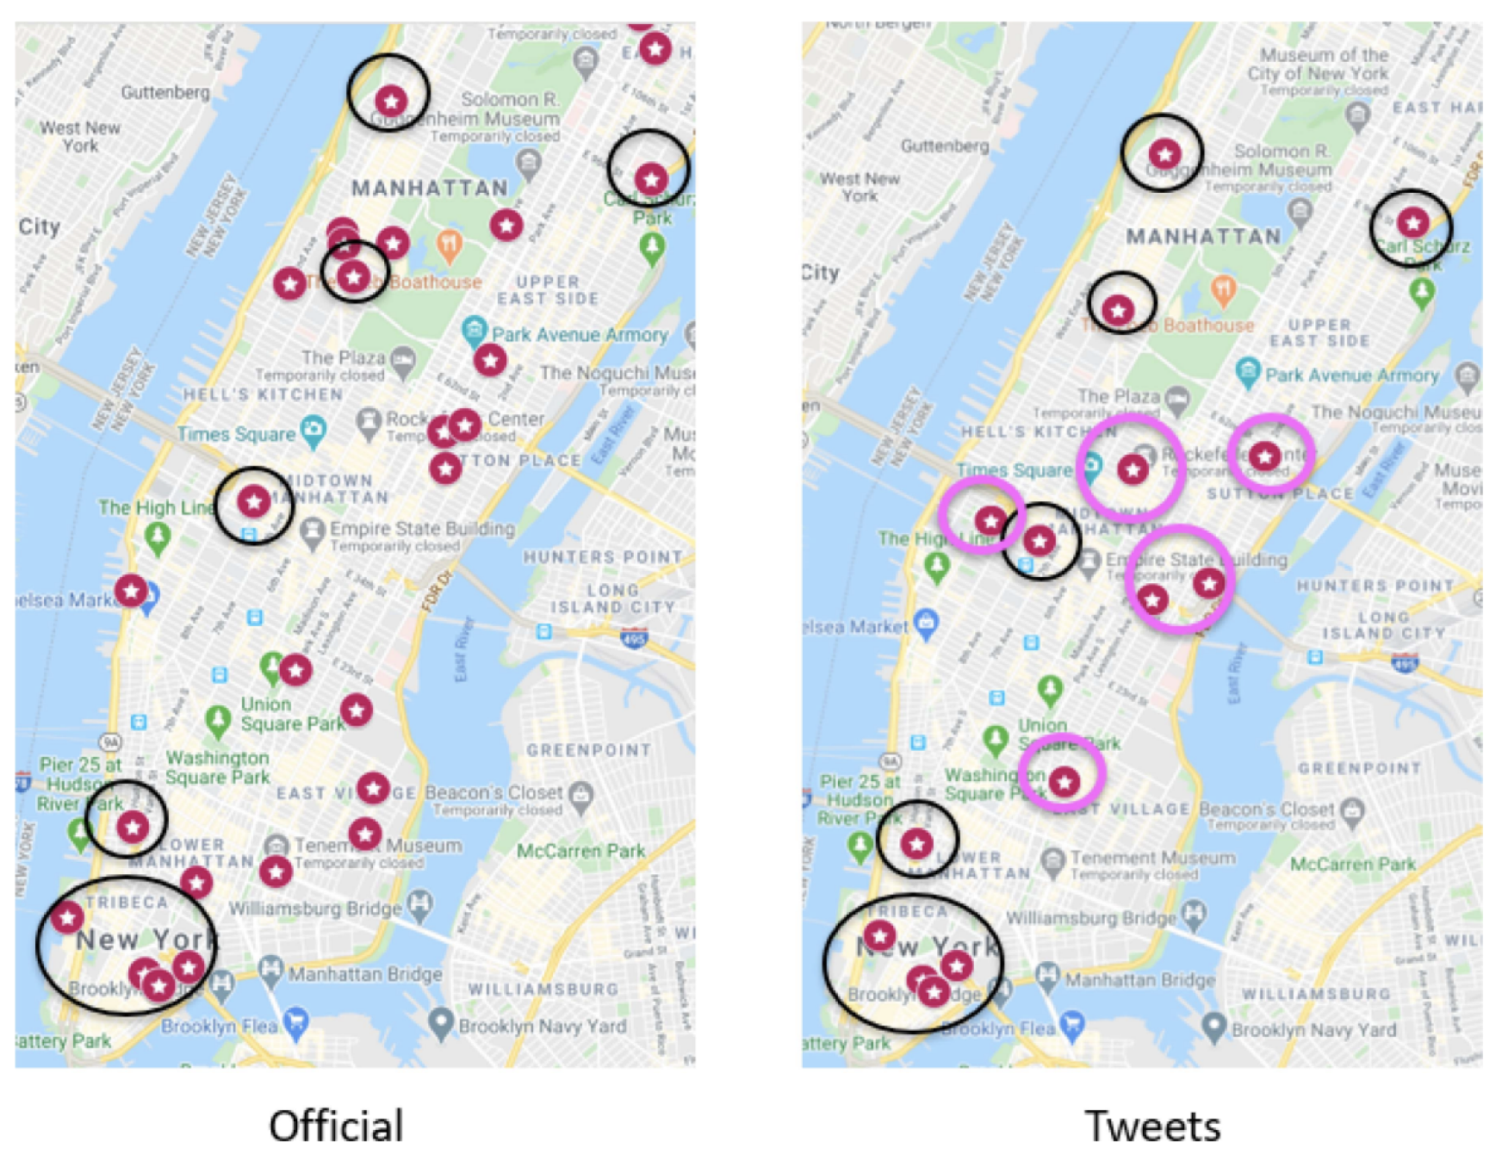
Accidents reported by NYC DOT and by social media (tweets) in 01/28/2020, Manhattan.
We plotted the geographical coordinates of the events reported by the NYC DOT and the data gathered, in real-time, from Twitter.
The incidents reported by both sources are outlined with black ovals, while the incidents that are exclusively reported by social media are highlighted with pink ovals.
On the other hand, the social media posts tend to concentrate around the main external access points to the city such as bridges and the tunnels where severe congestion usually occur.

Slide 11
CONCLUSION
In this article, we discussed the related efforts of researchers to develop data-driven intelligent transportation systems with the based-on crowdsourcing. In addition, we proposed an automated traffic information extractor framework based on state-of-art NLP techniques. After, we utilized our BERT model to filter out unrelated transportation information. We then built and compared QA and NER models that classified reported events and extracted relevant information from them.
Our methods were then used to build a system that can rapidly integrate generated reports into platforms that can help drivers assess the traffic conditions and plan their trip accordingly. The performance of the proposed framework has been experimented on the area of Manhattan, New York City, where real-time traffic maps are automatically updated using information extracted by scraping Twitter.
We then compared different data sources and show that social media sources could be a useful complementary data stream for the official transportation agencies.
Our study focused on the use-case of assisting the navigation of drivers, but NLP has great potential for other ITS applications such as public transportation operation/alert systems, monitoring malicious/dangerous/inattentive driver behavior, etc. at low cost, quickly, with widespread coverage, and from a very large pool of potential information.

Slide 12
Future Research Directions and Perspectives
1. Task Recruitment/Rewarding Systems.
Potential recruitment and reward policies can be to improve the standing of the poster by granting them titles such as “contributor”, “senior contributor”, etc., based on their performance
This accuracy score could correspond with the mentioned contributor titles, where people that post information with a high degree of veracity are rewarded, and malicious or uninformed users are ranked lower, or even blocked if necessary.
2. Reduced Data Entry Barriers.
Effective Speech to Text (STT) systems would improve hands-free interaction between the driver and their mobile devices.
vehicles are equipped with sophisticated arrays of sensors such as LiDAR's, Radars, cameras, etc, there is potential for systems that automatically collect & process information related to the vehicle’s surroundings.
3. Quantifying Incident Severity.
The use of information to quantify the severity of an incident is useful as an information filter, so that users of the traffic monitoring system are not overwhelmed with unnecessary alerts.
4. Standard Text Generation Of GIS Coordinates And Privacy Issues.
One of the main challenges is to transform the street name to GIS coordinates, as our method has some limitations.
Collection of GIS coordinates from the driver’s post would simplify the process, but this would require robust privacy and security considerations, such as end-to-end encryption, to protect users from malicious actors.

Slide 13
References
[1] X. Wan, H. Ghazzai, and Y. Massoud, “Leveraging personal navigation assistant systems using automated social media traffic reporting,” in Proc. IEEE Technol. Eng. Manag. (TEMSCON), Novi, MI, USA, Jun. 2020, pp. 1–6.
[2] “New York City mobility report 2019,” NYC Dept. Transp., New York, NY, USA, Rep., Aug. 2019. [Online]. Available: https://www1.nyc. gov/html/dot/downloads/pdf/mobility-report-singlepage-2019.pdf
[3] A. Noto, “NYC economy May be losing 20 billion a year due to traffic congestion,” New York Bus. J., New York, NY, USA, Rep., Jan. 2018. [Online]. Available: https://www.bizjournals.com/newyork/news/2018/ 01/17/nyc-economy-may-lose-due-to-traffic-congestion.html
[4] J. R. Short, “New York gets serious about traffic with the first citywide us congestion pricing plan,” Convers. Media Group, Parkville, VIC, Australia, Rep., Apr. 2019. [Online]. Available: https://www. salon.com/2019/04/05/new-york-gets-serious-about-traffic-with-thefirst-citywide-us-congestion-pricing-plan_partner/
[5] A. Rosen, “What really causes traffic congestion?” Bklyner, Brooklyn, NYC, USA, Rep., Jul. 2013. [Online]. Available: https://bklyner.com/ what-really-causes-traffic-congestion-sheepshead-bay/

Slide 14

Thank you

